Slide 1



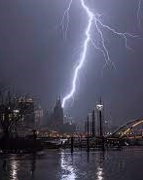

Weather: Nashville Tennessee
Nashville, Tennessee, known as the "Music City," is a vibrant and dynamic city with a rich cultural heritage. Located in the heart of the state, Nashville offers a unique blend of history, music, and southern charm. Renowned for its thriving music scene, the city is home to the Grand Ole Opry, the Country Music Hall of Fame, and countless live music venues.
84°F Humidity: 52%
Wind: 9 mph
Nashville Tennesse 84°F Humidity: 52%
Wind: 9 mph
Nashville Tennessee is widely known as the music city!!

Slide 2
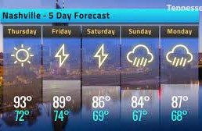

Nashville Tennesse 84°F Humidity: 52% Wind: 9 mph
Nashville, Tennessee, known as the "Music City," is a vibrant and dynamic city with a rich cultural heritage. Located in the heart of the state, Nashville offers a unique blend of history, music, and southern charm. Renowned for its thriving music scene, the city is home to the Grand Ole Opry, the Country Music Hall of Fame, and countless live music venues.

